Slide 1

Project Title: Behavioral Finance Patterns in Predicting Global Financial Crises: An Analytical Approach to Crisis Forecasting
Domain: Economics & Finance
First Review
Course Code: CS6510
Course Title: Project 1
Register Number: 23MSP3068
Name: Dharshani A.
Date: 27-11-2023

Slide 2
INTRODUCTION
The financial sector is ever-evolving, and there's a critical need for models that can predict crises before they occur.
Traditional methods, while useful, often fall short in capturing the complex dynamics of economic fluctuations.
This study addresses this gap by constructing a predictive model that not only analyzes a wealth of historical economic data, market behaviors, and financial information from past global downturns but also introduces an innovative approach.
By integrating SARIMAX for seasonal trend analysis and Neural Networks for pattern recognition in economic data, this research offers a comprehensive tool for forecasting financial crises.
Utilizing a dataset from Global Financial Crisis Analytics, the study combines ARIMA time series analysis with advanced machine learning methods to detect intricate economic patterns and interactions.
The outcomes of this research are significant, as they provide new directions for lessening financial risks and bolstering the economy's defenses against instability.
This integration of tried-and-true econometric techniques with modern machine learning technology offers fresh insights into behavioral finance and a robust model for predicting when the economy might face a downturn.

Slide 3
Problem Statement
Traditional economic forecasting methods lack the finesse to predict financial crises accurately, missing complex and seasonal trends.
This study proposes a novel model integrating SARIMAX, for its strength in seasonal analysis, with Neural Networks, adept at uncovering non-linear patterns.
Aimed at equipping policymakers with timely, actionable insights, this hybrid approach seeks to enhance the precision of crisis prediction, ensuring robust economic defense strategies.

Slide 4
Objectives
Aim:
To enhance the accuracy of financial crisis forecasting by developing a hybrid predictive model that incorporates SARIMAX for seasonal trend analysis in economic time series and Neural Networks to identify complex patterns in financial indicators.
Need for Research:
To maintain vigilance in the financial sector and among policymakers and investors for the anticipation and mitigation of future financial downturns.
To leverage SARIMAX in identifying seasonal and cyclical trends within economic data that traditional forecasting methods may overlook.
To harness the capabilities of Neural Networks in recognizing subtle and non-linear patterns that serve as early warning signals of potential financial crises.
To analyze historical data and key economic indicators, specifically examining changes leading up to the 2007-2008 crisis, to refine the model's forecasting capabilities.
To enable stakeholders to take preemptive measures to protect the global economy by predicting potential crises with greater precision.

Slide 5
Review of Related Literature
Title of the Paper | Authors | Journal Name/ Conference Title & Publisher | Year of Publication | Methodology used | Performance of the proposed algorithm | Limitations of the Research | Future approach if any
2018 Financial Risk and Regulation Survey: Behavioral Finance & Financial Stability | Harvard Business School | Harvard Business School | 2018 | The study employed a combination of regression analysis, econometric methods, and possibly modern machine learning techniques, given its focus on understanding and forecasting financial downturns. | The study focuses on the analysis of financial risks such as asset price inflation and high debt, contributing to a better understanding of financial instabilities. | Potential limitation in integrating traditional and modern techniques effectively. | The study can be expanded with traditional time series analysis, including ARIMA models, with advanced machine learning techniques, to discern cyclical patterns and complex interactions among various economic factors
Previous studies have focused on ARIMA models for economic forecasting, but they fall short in handling complex, non-linear patterns. Recent advancements in machine learning, particularly Neural Networks, have shown potential in financial applications. This research builds upon these findings, proposing a novel integration of SARIMAX and Neural Networks.

Slide 6
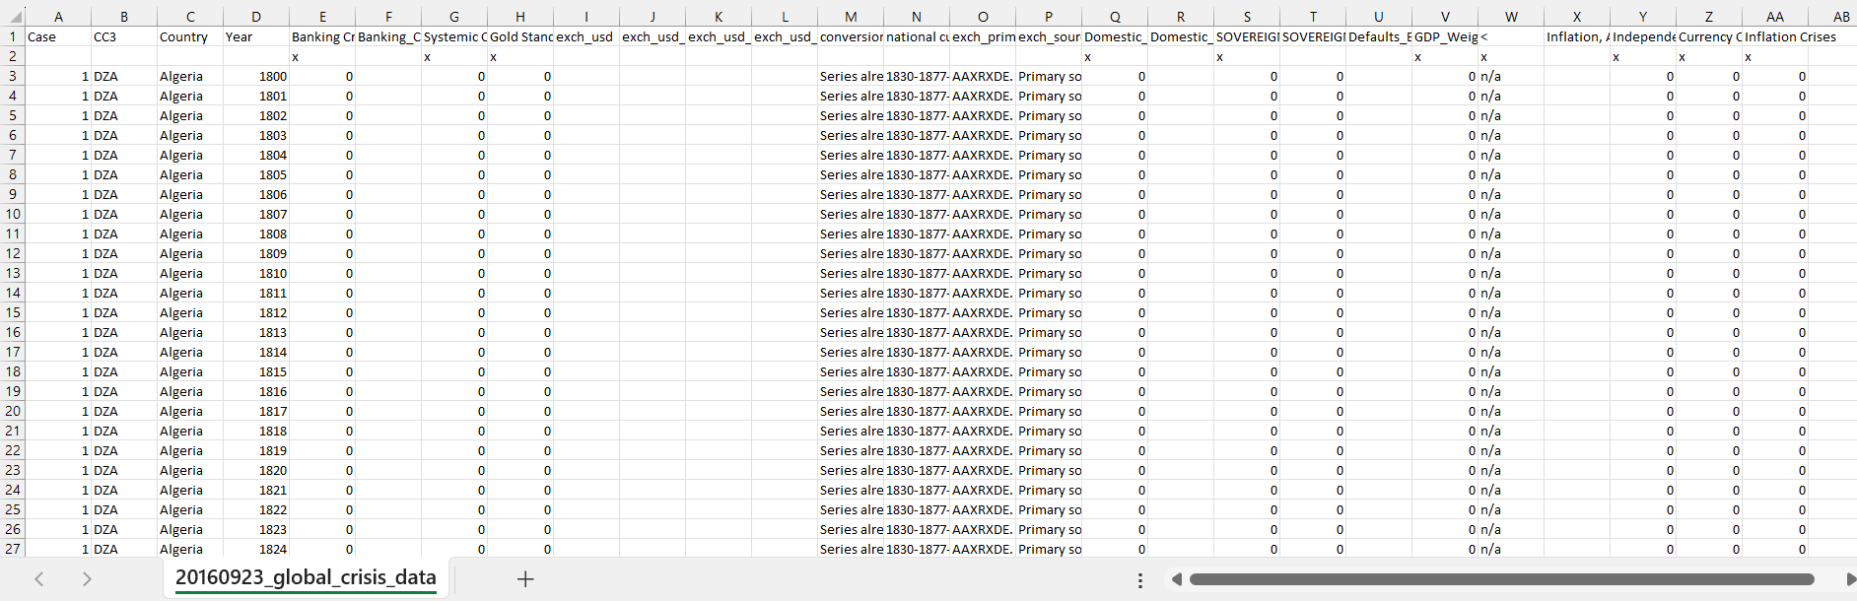
Dataset
Source of the Dataset: Global Financial Crisis Analytics | Kaggle
No. of Observations: 15,192
Screenshot of the dataset
CS6501 Project I PGP, ICER, VIT Bangalore
6

Slide 7
Column/Feature Details of the Dataset
1. Case: A numeric identifier for each record. Each country appears to have a unique case number.
2. CC3: The three-letter country code, following the standard ISO alpha-3 country codes.
3. Country: The name of the country to which the data row corresponds.
4. Year: The year for which the data is recorded.
5. Banking Crisis: Indicates the occurrence of a banking crisis. '0' indicates no crisis, while '1’ indicates a crisis.
6. Banking_Crisis_Notes: Additional notes or explanations about the banking crisis, if any.
7. Systemic Crisis: Indicates whether a systemic crisis occurred in that year. Similar to 'Banking Crisis', '0' likely means no systemic crisis.
8. Gold Standard: Indicates whether the country was on the gold standard in that year.
9. exch_usd: The exchange rate of the country's currency to the US dollar.
10. exch_usd_alt1, exch_usd_alt2, exch_usd_alt3: Alternative exchange rate values, representing different sources or calculation methods.
11. Conversion to USD notes/sources: Notes or sources for the exchange rate data.

Slide 8
Column/Feature Details of the Dataset (continued)
12. Domestic Debt In Default: Indicates whether there was a default on domestic debt.
13. Domestic_Debt_ Notes/Sources: Notes or sources regarding the domestic debt data.
14. SOVEREIGN EXTERNAL DEBT 1 and 2: Indicates whether there was a default or restructuring of sovereign external debt. Different columns might represent different categorizations or time periods of the debt.
15. Defaults_External_Notes: Notes about external debt defaults.
16. GDP_Weighted_default: A measure of defaults weighted by GDP, possibly indicating the severity or impact of the default relative to the country's economy.
17. Inflation, Annual percentages of average consumer prices: The annual inflation rate, measured as the percentage change in consumer prices.
18. Independence: Indicates whether the country was independent in that year.
19. Currency Crises: Indicates the occurrence of a currency crisis.
20. Inflation Crises: Indicates the occurrence of an inflation crisis.

Slide 9
Details about the columns
Categorical Columns:
CC3, Country, Banking Crisis, Banking_Crisis_Notes, Systemic Crisis, Gold Standard, exch_usd, exch_usd_alt2, exch_usd_alt3, conversion_notes, national currency, exch_primary source code, exch_sources, Domestic_Debt_In_Default, Domestic_Debt_Notes/Sources, SOVEREIGN EXTERNAL DEBT 1: DEFAULT and RESTRUCTURINGS, 1800-2012, SOVEREIGN EXTERNAL DEBT 2: DEFAULT and RESTRUCTURINGS, 1800-2012, Defaults_External_Notes, GDP_Weighted_default, "<", Inflation, Annual percentages of average consumer prices, Independence, Currency Crises, Inflation Crises.
Continuous Columns:
Case, Year, exch_usd_alt1.
Discrete Columns:
None identified as discrete based on the provided data.

Slide 10
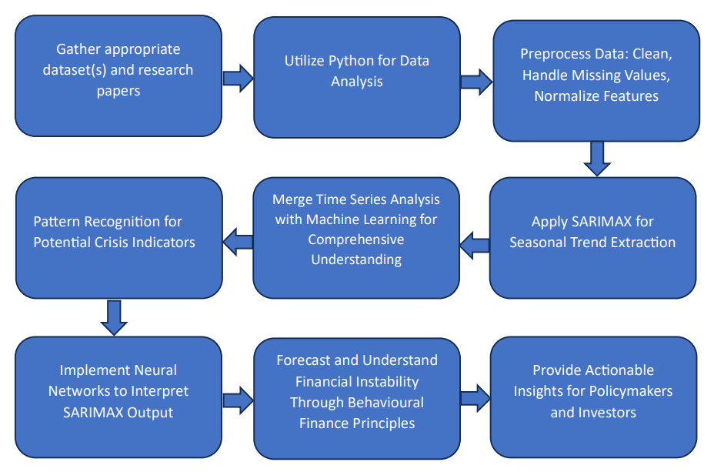
Proposed Methodology
Utilizing Python's data analysis ecosystem for its robust capabilities in handling extensive economic datasets.
Preprocessing involves cleaning the data, handling missing values, and normalizing features to prepare for advanced analysis.
Implementing SARIMAX models to capture and analyze seasonal trends and cycles within the economic time series data.
Integrating Neural Networks to interpret the SARIMAX output, focusing on pattern recognition to identify potential leading indicators of financial crises.
Aiming for a comprehensive understanding of the predictors of financial crises through a combined approach of time series decomposition and machine learning-based pattern identification.
The approach is rooted in behavioral finance, leveraging regression analysis alongside machine learning to forecast and understand financial instability.
This methodology is designed to unveil a clear relationship between economic indicators and the onset of financial crises, providing actionable insights for policymakers and investors.

Slide 11
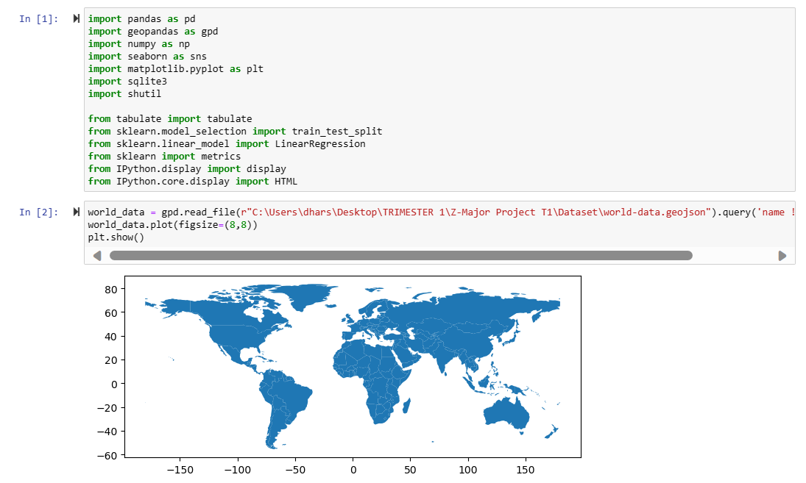
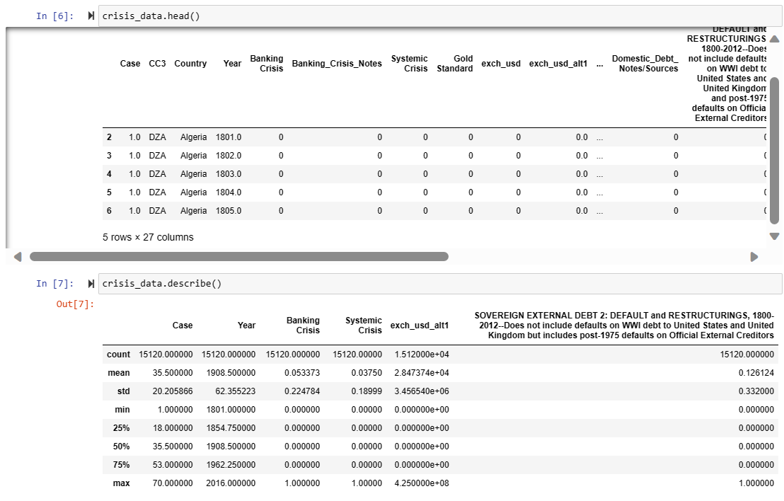
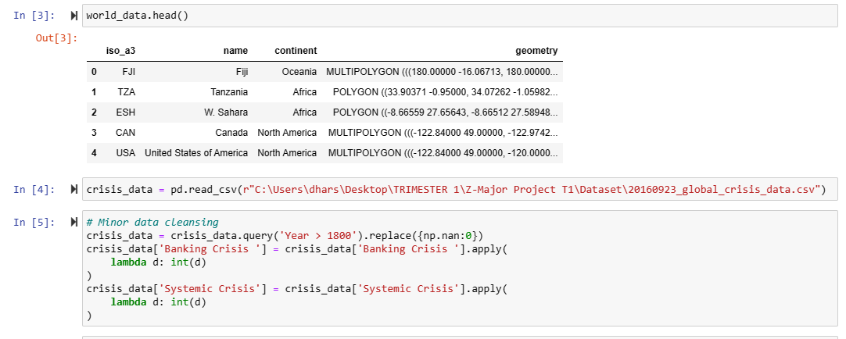
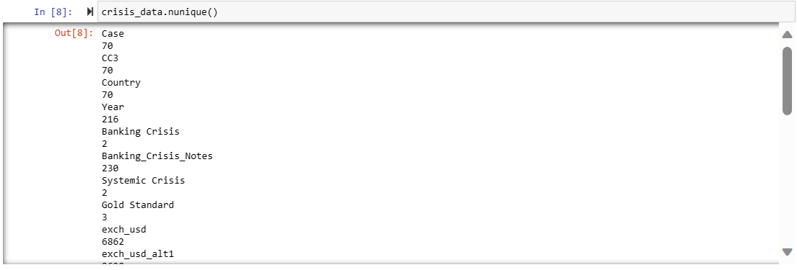
Exploratory Data Analysis

Slide 12
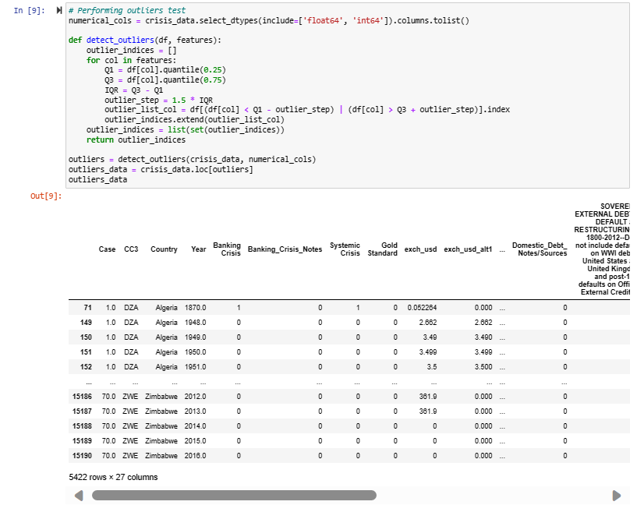
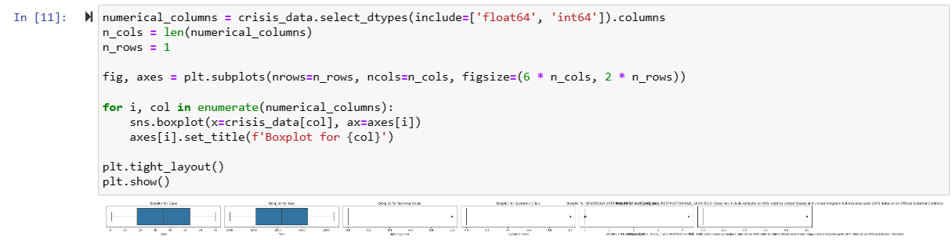
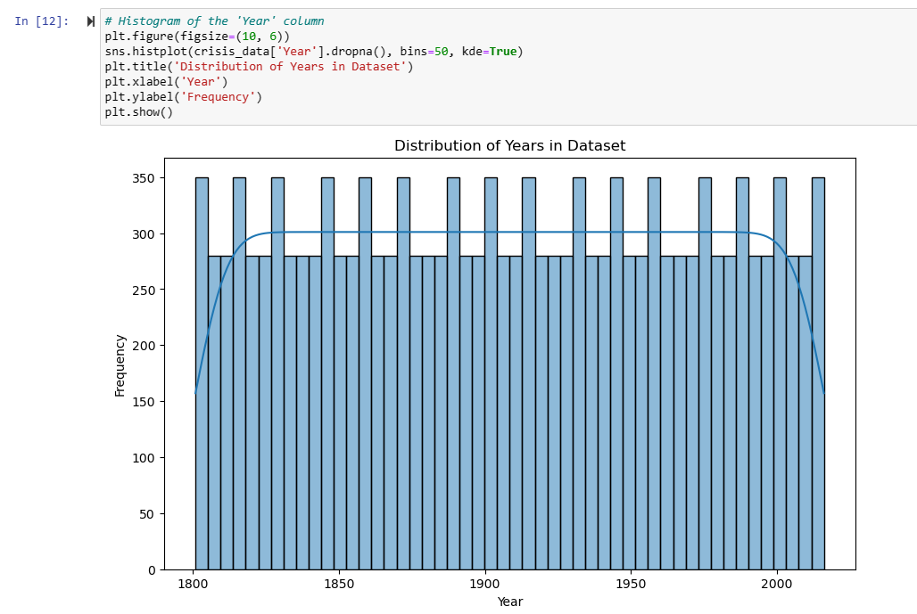
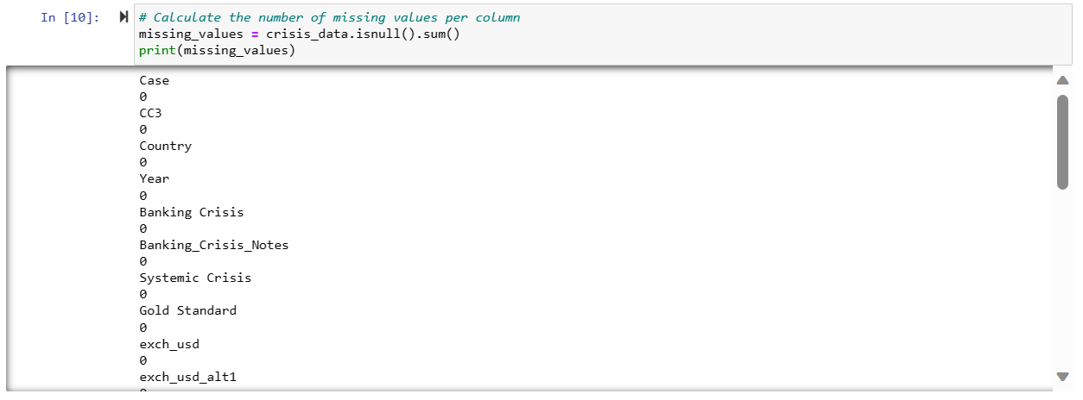
Exploratory Data Analysis

Slide 13
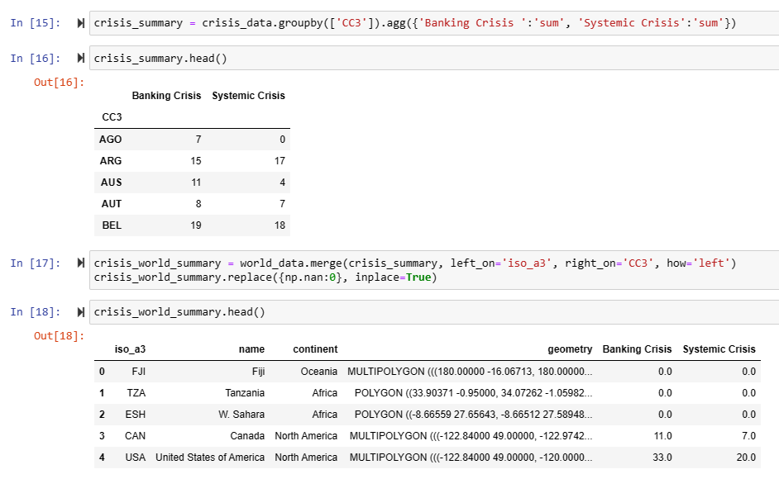
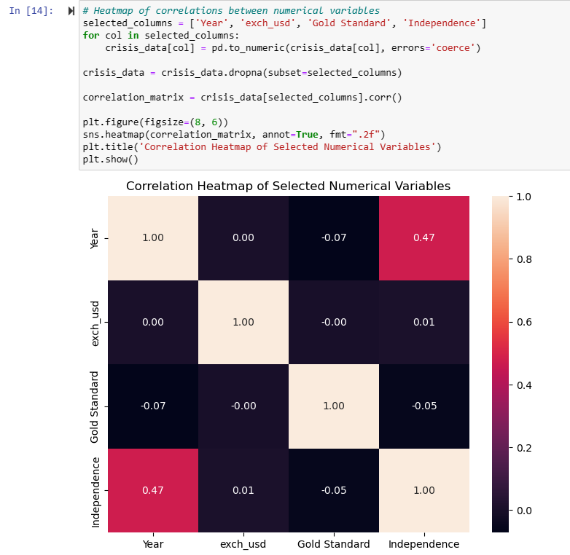
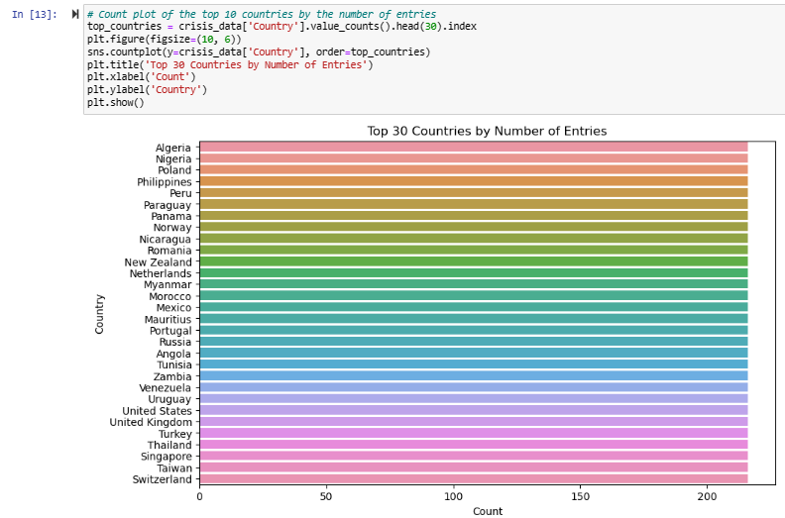
Exploratory Data Analysis

Slide 14
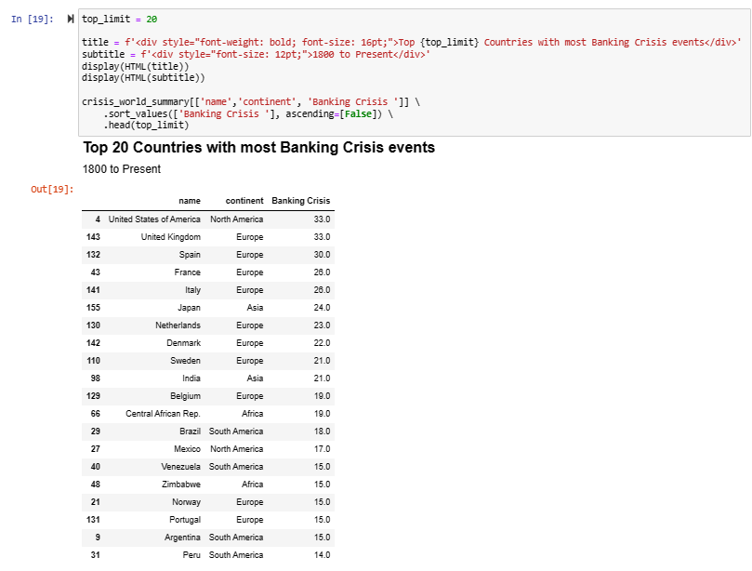
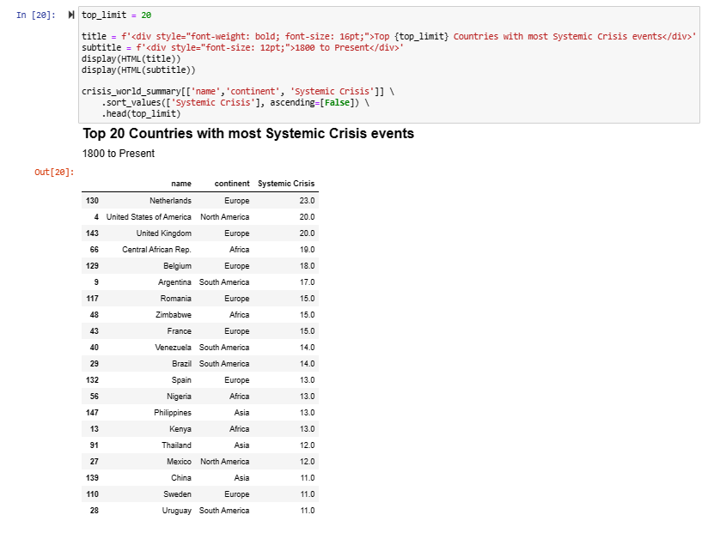
Exploratory Data Analysis

Slide 15
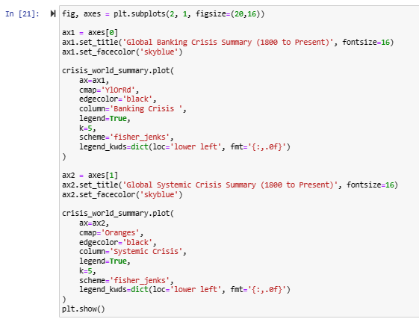
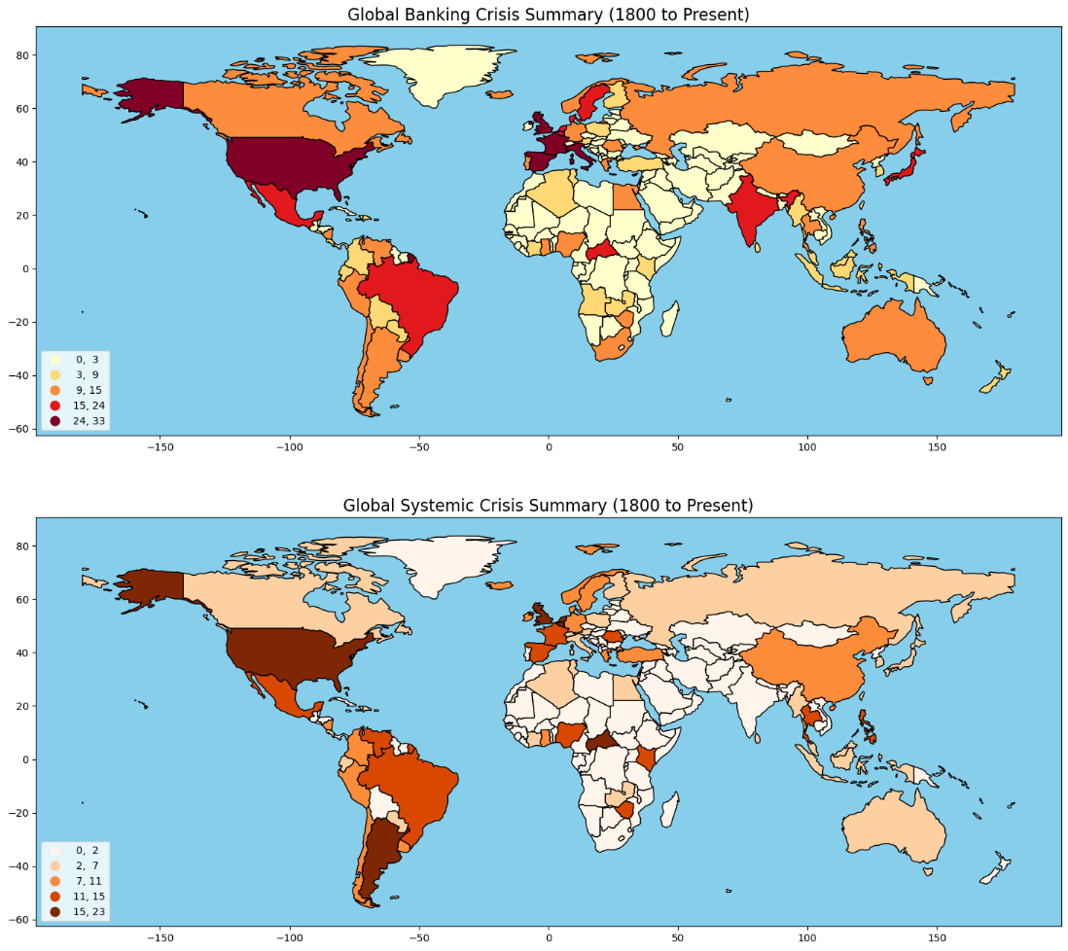
Exploratory Data Analysis

Slide 16
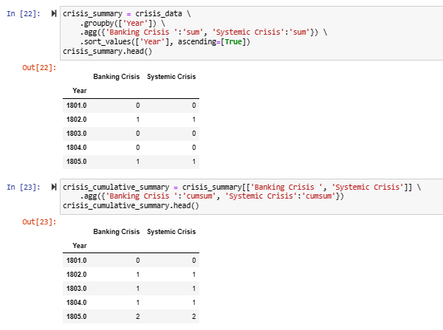
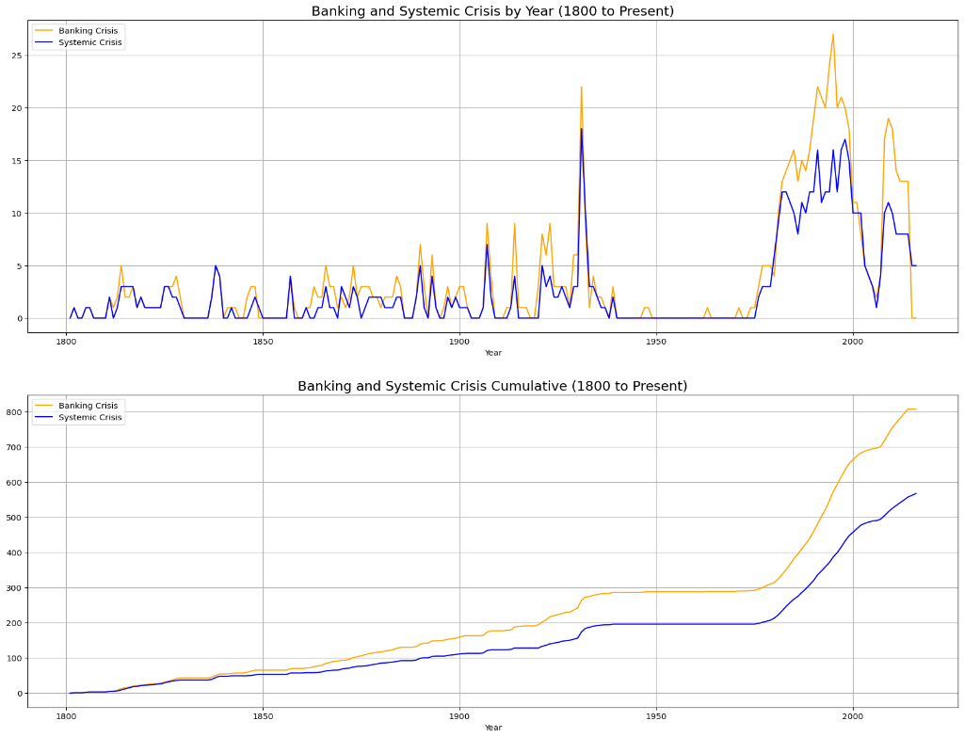
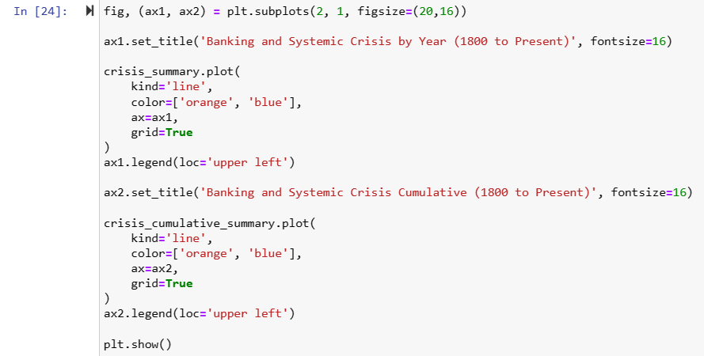
Exploratory Data Analysis

Slide 17
Next Step of Research Focus
To advance the predictive analysis of financial crises:
Validate the SARIMAX-neural network model using past crisis events for improved forecast reliability.
Examine emergent patterns from the model to identify key predictors of market downturns.
Establish a real-time data analysis framework for proactive economic decision-making.
Evaluate model performance through case studies, including its applicability to the recent pandemic's economic effects, thus addressing the current gap in applying advanced predictive models to modern financial challenges.

Slide 18
Conclusion

Slide 19
References : APA format
Harvard Business School. (2018). 2018 Financial Risk and Regulation Survey: Behavioral Finance & Financial Stability.
Tekin, H. (2020). How optimal cash changed by the global financial crisis?. Economics and Business Letters, 9(2), 114-123.
World Bank. (2020). Global Financial Development Report 2019/2020: Bank Regulation and Supervision a Decade after the Global Financial Crisis.
Lajili, K., Li, T. M., Chourou, L., Dobler, M., & Zéghal, D. (2023). Corporate risk disclosures in turbulent times: An international analysis in the global financial crisis. Journal of International Financial Management & Accounting.
Shehzad, K., Xiaoxing, L., & Kazouz, H. (2020). COVID-19’s disasters are perilous than Global Financial Crisis: A rumor or fact?. Finance Research Letters, 36.
Lolea, I.-C., Petrariu, I.-R., & Giurgiu, A. (2021). ARIMA vs. MACHINE LEARNING IN TERMS OF EQUITY MARKET FORECASTING. The Annals of the University of Oradea. Economic Sciences, XXX(2), 299-308.
Tang, Y. M., Chau, K.-Y., Li, W., & Wan, T. W. (2020). Forecasting Economic Recession through Share Price in the Logistics Industry with Artificial Intelligence (AI). Computation, 8(3).
Liu, J., Yan, R., & Zhang, Y. (2023). Stock Market Forecasting Using the ARIMA GARCH and Random Forest Model During The Russia–Ukraine War. Applied Economics and Policy Studies book series (AEPS), Springer.
Zulkefly, R. N., Karim, A. A., Rahman, A. A., & Sarmidi, T. (2020). Financial inclusiveness and economic growth: New evidence using a threshold regression analysis. Economic Research-Ekonomska Istraživanja, 33(1), 1465-1484.
Hossain, M. J. (2023). Comparative Analysis of ARIMA SARIMAX and Random Forest Models for Forecasting Future GDP in Relation to Unemployment Rate.

